Slide 1



SARS-Cov-2 Spike Protein Analysis using second Vassiliev Measure
UTC iCompBio REU 2021
Jason Middlebrook
Professor Eleni Panagiotou

Slide 2
Background

Slide 3
Protein Structure
Primary, Secondary, and Tertiary structure

Slide 4
SARS-CoV-2 spike protein
Binds to the human ACE2 receptor

Slide 5
The Second Vassiliev Measure
A topological measure for both closed and open knots

Slide 6
Methods

Slide 8
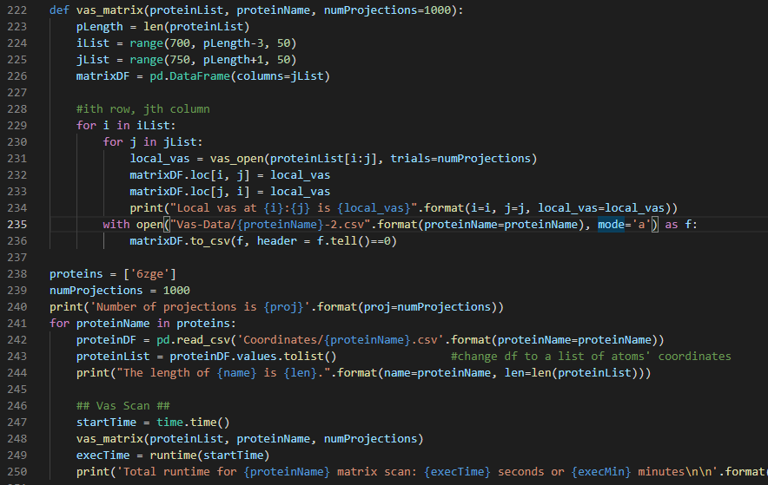
Code Example

Slide 9

Total Values Of V2 For Proteins At 100 And 1000 Projection Sizes

Slide 10
Total Values Of V2 For Proteins At 1000 And 2000 Projection Sizes

Slide 11
Results

Slide 12
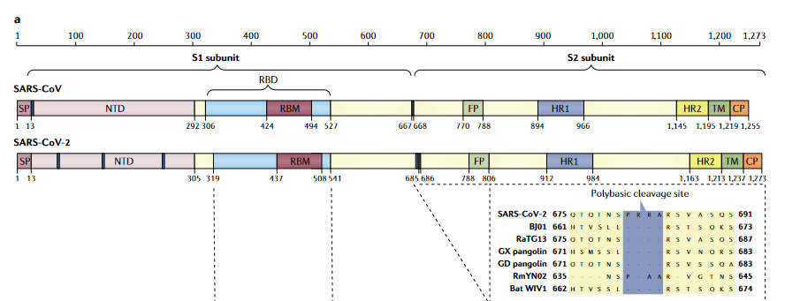
Protein Structure and Approximate Domains
Source: [1], figure 3a

Slide 13
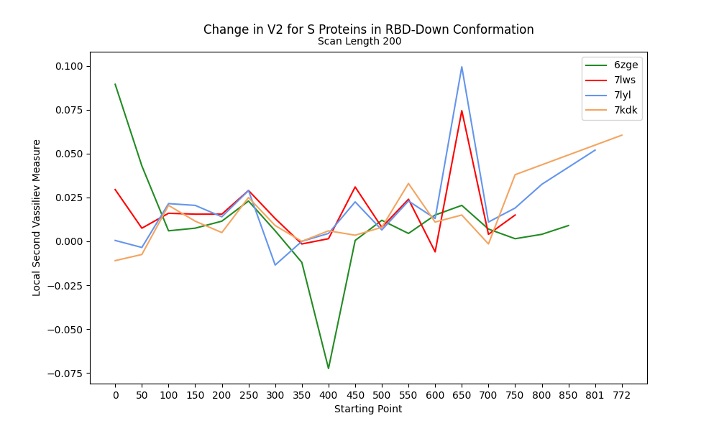
Change in V2 along RBD-Down Proteins

Slide 14
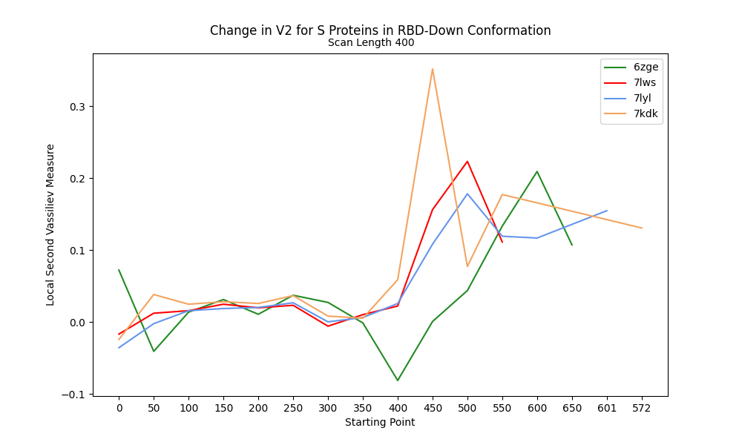
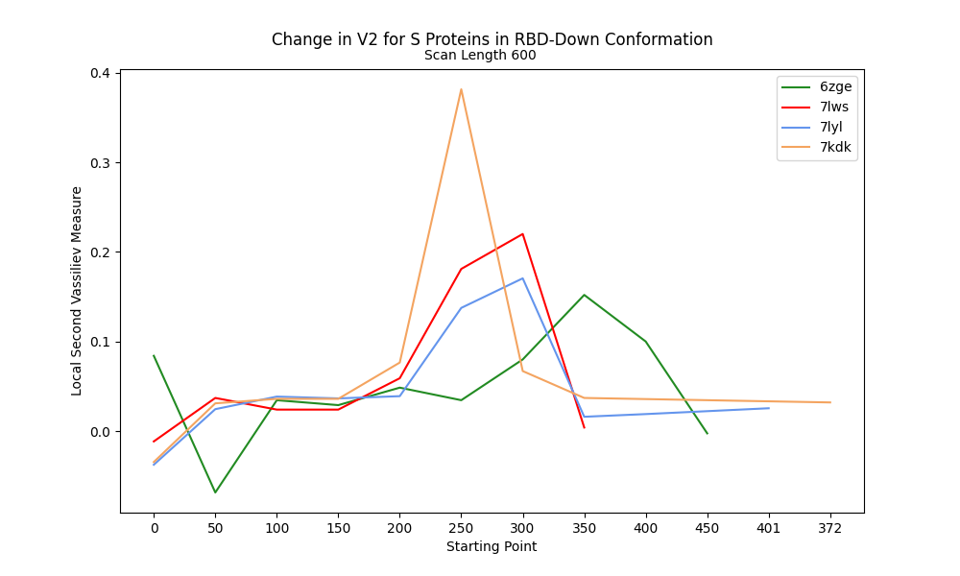
V2 along RBD-Down Proteins at 400 and 600 Scanning lengths

Slide 15
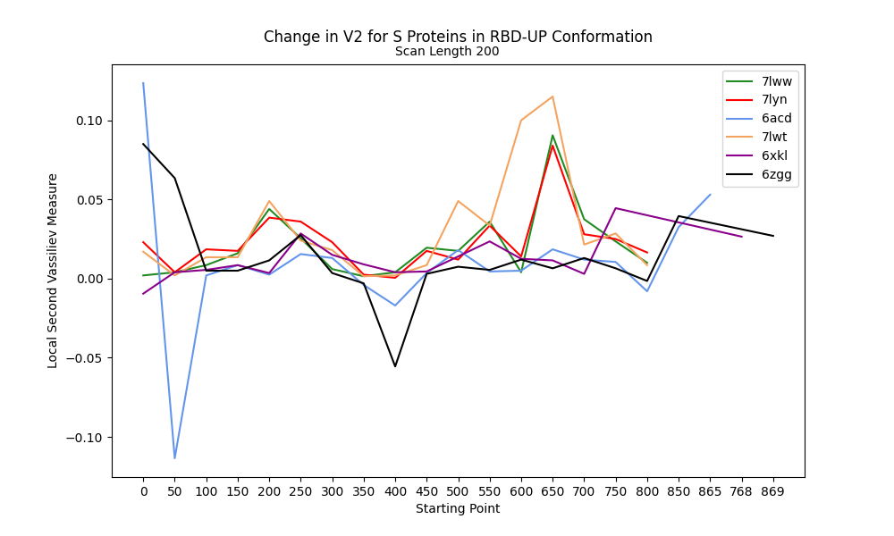
Change in V2 at 200 Scan Length for RBD-Up

Slide 16
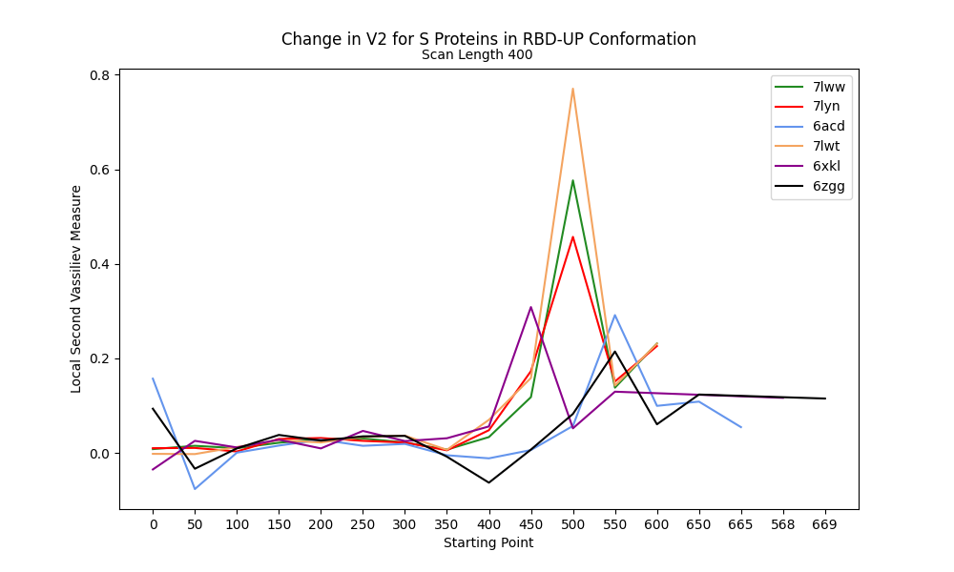
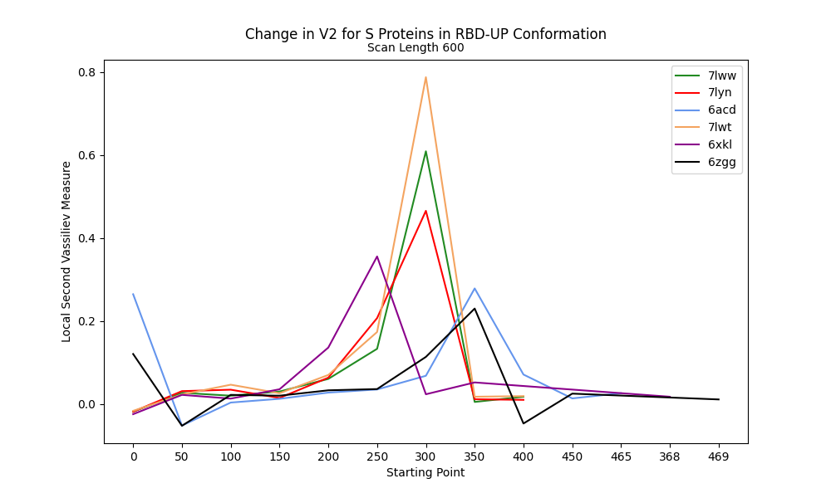
V2 along RBD-Up Proteins at 400 and 600 Scanning lengths

Slide 17
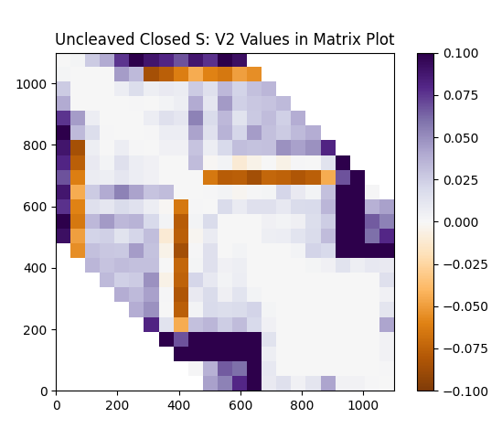
Difference Distance Matrix (DDM) for the V2 values Of The Uncleaved Closed S Protein For SARS-CoV-2 (PDB: 6zge)

Slide 18
Next steps

Slide 19
Acknowledgements
I would like to thank and acknowledge support from my mentor, Professor Eleni Panagiotou
I would also like to thank and acknowledge support from Dr. Hong Qin and the University of Tennessee Chattanooga iCompBio REU
Thanks to the NSF REU award #1852042

Slide 20
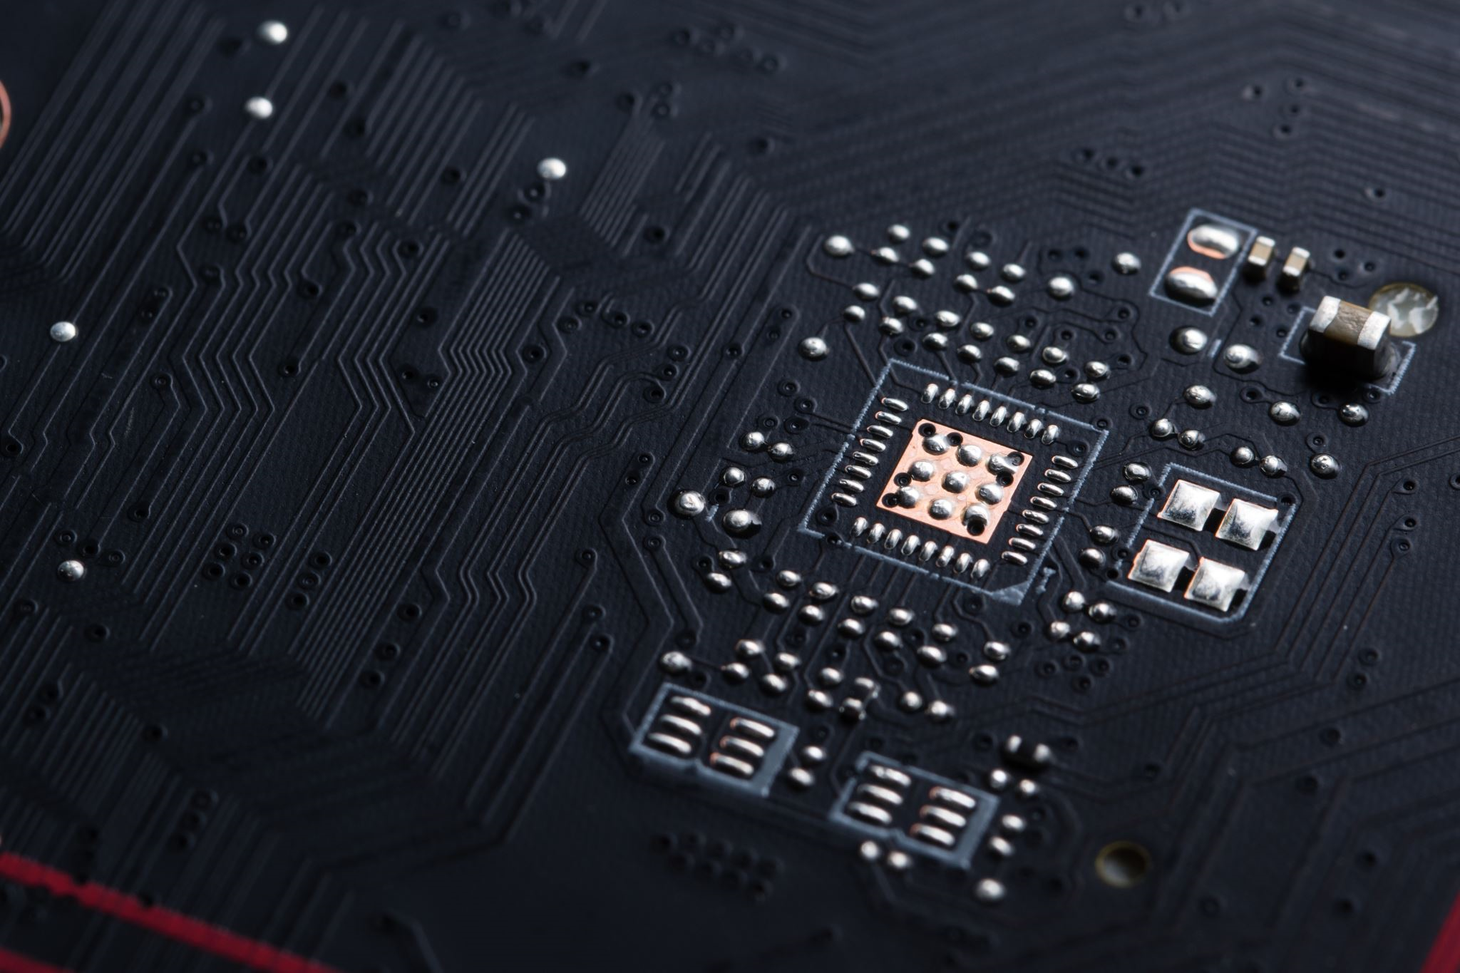
THANK YOU
References:
Hu, B., Guo, H., Zhou, P. et al. Characteristics of SARS-CoV-2 and COVID-19. Nat Rev Microbiol 19, 141–154 (2021). https://doi.org/10.1038/s41579-020-00459-7
https://github.com/MiddlebrookJF/iCompBio-Summer2021
MiddlebrookJF@gmail.com

